Slide 1
Multithreading in Python

Slide 2
Thread
In computing, a process is an instance of a computer program that is being executed. Any process has 3 basic components:
An executable program.
The associated data needed by the program (variables, work space, buffers, etc.)
The execution context of the program (State of process)
A thread is an entity within a process that can be scheduled for execution. Also, it is the smallest unit of processing that can be performed in an OS (Operating System).

Slide 3
In simple words, a thread is a sequence of such instructions within a program that can be executed independently of other code. For simplicity, you can assume that a thread is simply a subset of a process!
A thread contains all this information in a Thread Control Block (TCB):
Thread Identifier: Unique id (TID) is assigned to every new thread
Stack pointer: Points to thread’s stack in the process. Stack contains the local variables under thread’s scope.
Program counter: a register which stores the address of the instruction currently being executed by thread.
Thread state: can be running, ready, waiting, start or done.
Thread’s register set: registers assigned to thread for computations.
Parent process Pointer: A pointer to the Process control block (PCB) of the process that the thread lives on.

Slide 4
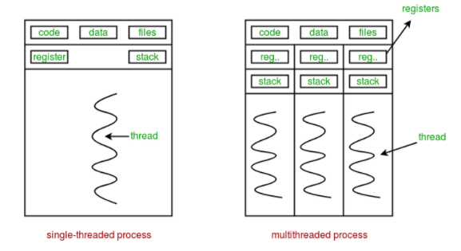
Multiple threads can exist within one process where:
Each thread contains its own register set and local variables (stored in stack).
All thread of a process share global variables (stored in heap) and the program code.
Multithreading is defined as the ability of a processor to execute multiple threads concurrently.

Slide 5
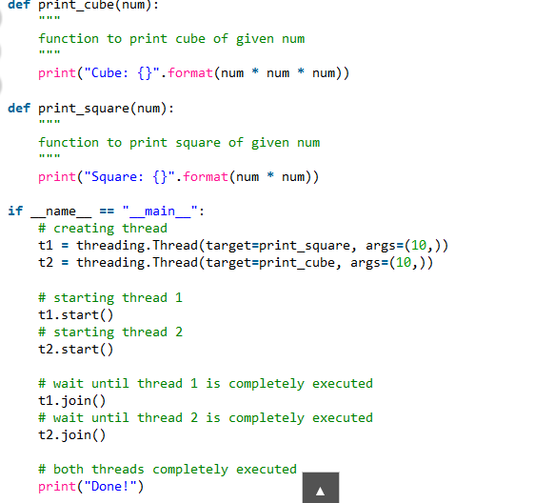

Slide 6
To import the threading module, we do: import threading
To create a new thread, we create an object of Thread class. It takes following arguments:
target: the function to be executed by thread
args: the arguments to be passed to the target function
In above example, we created 2 threads with different target functions:
t1 = threading.Thread(target=print_square, args=(10,)) t2 = threading.Thread(target=print_cube, args=(10,))
To start a thread, we use start method of Thread class. t1.start() t2.start()
Once the threads start, the current program (you can think of it like a main thread) also keeps on executing. In order to stop execution of current program until a thread is complete, we use join method. t1.join() t2.join() As a result, the current program will first wait for the completion of t1 and then t2. Once, they are finished, the remaining statements of current program are executed.

Slide 7
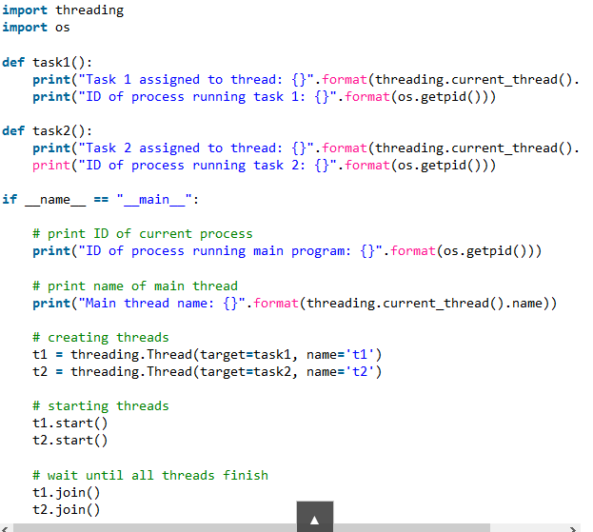
Consider the python program given below in which we print thread name and corresponding process for each task:

Slide 8
Let us try to understand the above code:
We use os.getpid() function to get ID of current process. print("ID of process running main program: {}".format(os.getpid())) As it is clear from the output, the process ID remains same for all threads.
We use threading.main_thread() function to get the main thread object. In normal conditions, the main thread is the thread from which the Python interpreter was started. name attribute of thread object is used to get the name of thread. print("Main thread name: {}".format(threading.main_thread().name))
We use the threading.current_thread() function to get the current thread object. print("Task 1 assigned to thread: {}".format(threading.current_thread().name))

Slide 9
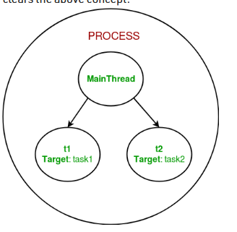
The diagram clears the above concept:

